Slide 1

RadarID
Radar-Based User Identification in Smart Environments
TEAM 5
Francisco Gonçalves
Guilherme Santos
Hugo Rodrigues
João Gaspar
Ricardo Dias
Sérgio Correia
Supervised by Dr.ª Ana Rocha, Prof. Samuel Silva
PECI 2023/2024

Slide 2
Presentation Outline
Context, Problem and Objective
Requirements Elicitation
Personas and Scenarios
System Requirements
Radar-Based User Identification in Smart Environments
User Identification Modality
Adaptation to the User (Dashboard)
User ID Model Evaluation
Demo
Conclusion
Future Work
RadarID
2
Notes:
Hoje em dia todos nós penso que concordamos

Slide 3
CONTEXT, PROBLEM & OBJECTIVE
RadarID
3

Slide 4
Context
Problem
Objective
In our Information Age, the intelligence integrated within our living spaces, notably our homes, is increasing prominence.
These environments incorporate sensors that enable us to manage household devices, monitor inhabitants, and gather insights about both the house itself and its occupants.
The identification of each user is essential. This process ensures that the collected data is associated with the correct person, allowing to display the relevant information specifically tailored to that person.
For that, it is required to distinguish between different subjects, identifying them.
The identification should be done in the less intrusive way, to be accepted by the users.
Introducing a radar-based approach for user identification we aim to:
Develop a low intrusive solution for identifying people in smart environments.
The solution should be based on:
Minimally intrusive sensors such as radars.
Machine learning techniques to distinguish between different people using the data from radar(s).
RadarID
4
Notes:
Hoje em dia todos nós penso que concordamos

Slide 5
REQUIREMENT ELICITATION
RadarID
5
Notes:
Hoje em dia todos nós penso que concordamos

Slide 6
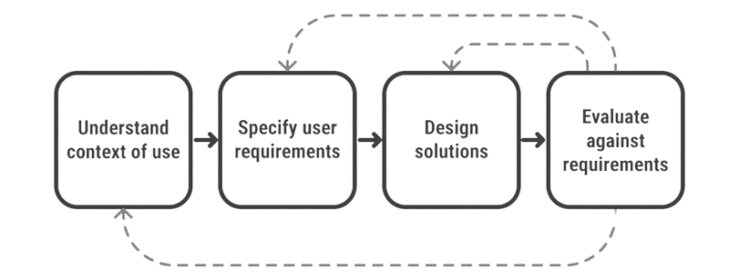
User-Centered Design
Our approach revolved around understanding the target users and their needs to retrieve system requirements.
By prioritizing user preferences, we enhance the potential of our solutions to seamlessly integrate into their lives, reducing their risk of ineffectiveness.
RadarID
6

Slide 7
Personas & Scenarios
Luísa:
Seeks activity monitor for exercise proof to doctor.
Ricardo:
Wants indoor Security system for family safety.
Maria:
Requires volume control system for son’s music upon her home arrival.
Pedro: Needs a kitchen alert system for Culinary duties reminder.
RadarID
7

Slide 8
Functional Requirements
Detect presence of individuals at a designated location
Distinguish and identify users based on their unique movement patterns
Store user movements, associated with their respective owner
Alert for the detection of unregistered individuals
Automatically adjust environment settings based on the user
Provide real-time updates on user presence and movements
RadarID
8

Slide 9
Non-Functional Requirements
Non-intrusive system, requiring no changes to the user's routine or capturing sensitive information (such as visual data)
Online implementation, identifying a user with a delay of less than X
Reliable user identification performance (accuracy over XX%)
Capable of handling increased data quantities
Easy maintenance and updates
Strong measures for data protection
Compliance with regulations and standards
RadarID
9

Slide 10
RADAR-BASED USER IDENTIFICATION IN SMART ENVIRONMENTS
RadarID
10
Notes:
Hoje em dia todos nós penso que concordamos

Slide 11
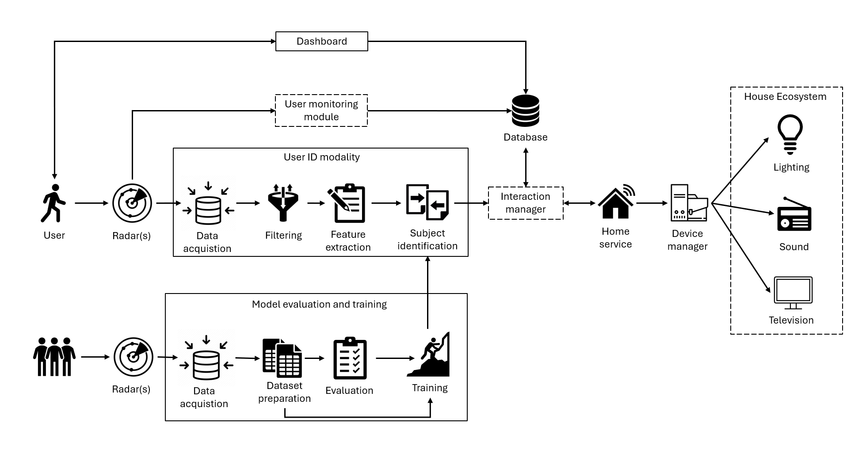
System Overview
Primary Focuses:
User ID Modality: Model Evaluation and Training
Secondary Focus:
Implement a simple interface for a dashboard that serves as a proof of concept for user adaptation.

Slide 12
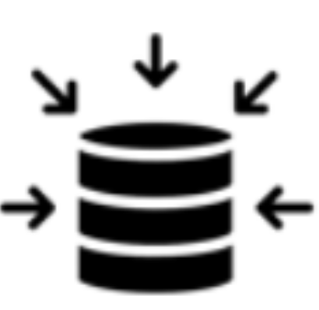


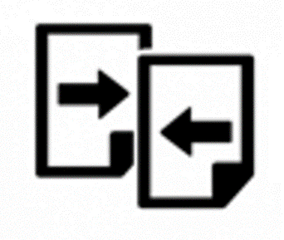
User Identification Modality
Data Acquisition
Data Filtering
Feature Extraction
Subject Identification
Receives raw radar data (TLV packets), parses them, and extracts essential information, i.e., 3D position and velocity (Doppler) of moving targets.
A sliding window is used to process the resulting information.
First step consists of filtering: remove some noise, namely by discarding targets with velocity <1e-5 m/s.
Extraction of features from filtered radar data:
Matrix associated to the heat map for each data type (X, Y, Z, Doppler) versus the elapsed time.
Vertical concatenation of matrices.
Resulting matrix converted to grayscale image.
Relies on a model for subject identification, which given a feature (grayscale image) outputs a user ID/name.
Model previously trained using Transfer Learning and a dataset corresponding to the subjects to be identified.
12

Slide 13

Pipeline Online
The User ID Modality leverages MQTT and Mosquitto for communication between the various modules, allowing them to be deployed in different computing units if needed.
13

Slide 14
Adaptation to the User (Dashboard)
Imagem das preferencias
Imagem do texto
Outra imagem do texto para comparação
14

Slide 15
USER ID MODEL EVALUATION
Notes:
Hoje em dia todos nós penso que concordamos

Slide 16
Setup and Methods
In our project, we designed a controlled testing room with specific dimensions and three distinct paths of movement.
By meticulously crafting this environment, we aimed to conduct systematic assessments and gather reliable data on the system's functionality and usability.
Meter aqui uma imagem das proporções da sala/quadrado.
16

Slide 17
First Evaluation
Imagem com a trajetoria
Imagem com greyscale image
Imagem dos resultados do Sérgio
Pros:
Cross-sectional view of the target object, aiding in spatial understanding, enhancing target discrimination, and reducing Doppler effects.
Cons:
Entails reduced coverage area and limited depth perception.
17

Slide 18
Second Evaluation
Pros:
Multi-dimensional view of the target object, facilitating a more nuanced assessment of target behavior.
Cons:
Entails complexities in data interpretation, susceptibility to Doppler effects and clutter, and requires greater computational and processing resources.
Imagem com a trajetoria
Imagem com greyscale image
Imagem dos resultados do Sérgio
18

Slide 19
Third Evaluation
Pros:
Streamlined data interpretation, with reduced susceptibility to Doppler effects and clutter, leading to simplified analysis processes.
Cons:
Limited versatility in capturing data from different angles or perspectives, resulting in a less comprehensive understanding of the target object.
Imagem com a trajetoria
Imagem com greyscale image
Imagem dos resultados do Sérgio
19

Slide 20
Final Results
Imagem dos resultados do Sérgio
Tabela com accuracy para cada um
Participants: 6 subjects were involved in the study;
Methods: 3 distinct trajectories were tested multiple times, each aligned with the radar orientation:
Perpendicular
Mixed (Perpendicular, diagonal & parallel)
Parallel
Each trajectory yielded slightly varied accuracies in correctly identifying the subjects.
20

Slide 21
Comparison to related work
Tabela que temos no relatorio de related work com os valores de distancia do radar, accuracy e adicionar os nossos valores
21

Slide 22
DEMO
Notes:
Hoje em dia todos nós penso que concordamos

Slide 23
CONCLUSION
We achieved success in subject identification through radar technology, boasting high accuracy rates.
Leveraging cutting-edge machine learning techniques, we've harnessed the power of radar data to consistently and reliably identify subjects with precision.
23

Slide 24
Achievements
Notes:
Hoje em dia todos nós penso que concordamos

Slide 25
FUTURE WORK
Real-time recognition of multiple individuals.
Leveraging sophisticated algorithms, radar systems can discern unique biometric signatures within crowds.
Trajectory-independent identification
Accurately recognizing individuals regardless of movement patterns.
Future applications in dynamic environments
Security measures, optimizing event crowd flow, and enhancing personalized retail experiences.
Notes:
Hoje em dia todos nós penso que concordamos

Slide 26
THANK YOU!

